Slide 1

SI 507 FALL 2022 Intermediate Programming
Madamanchi

Slide 2
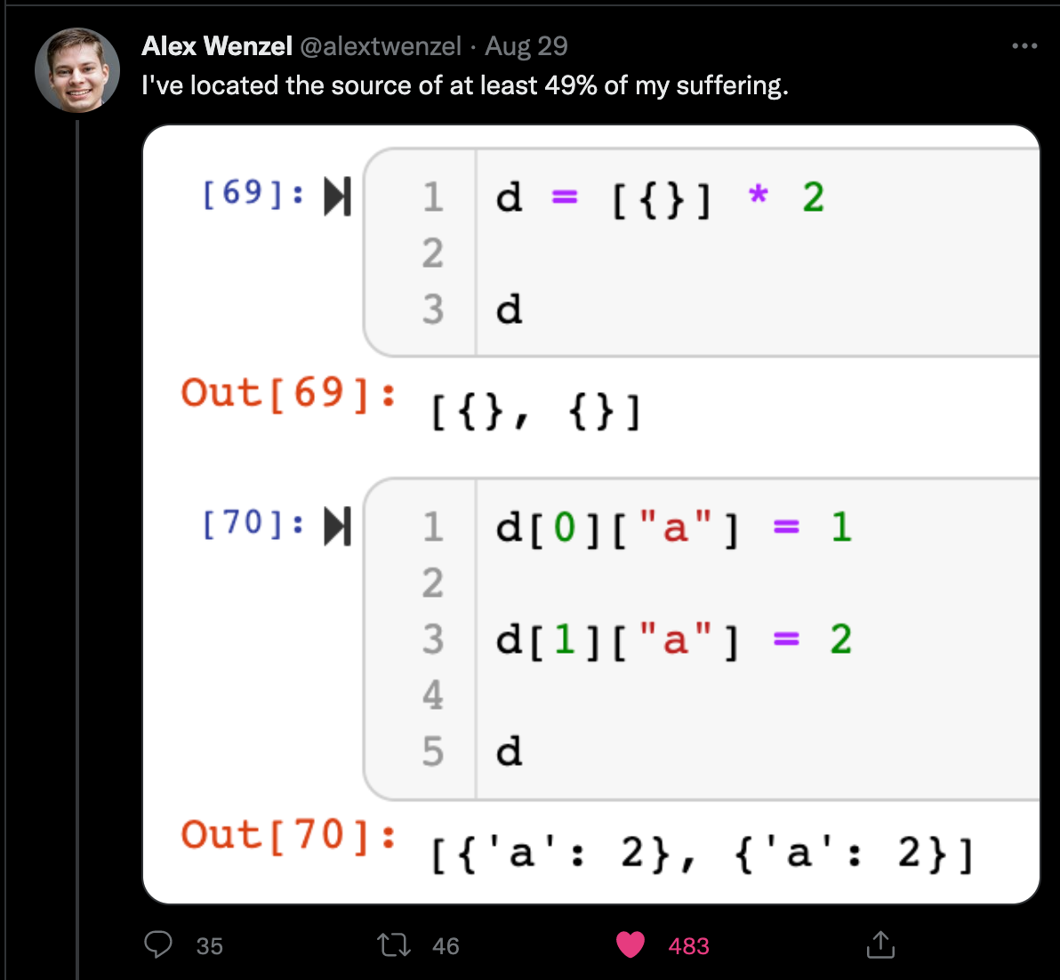
What IS GOING On HERE!

Slide 3
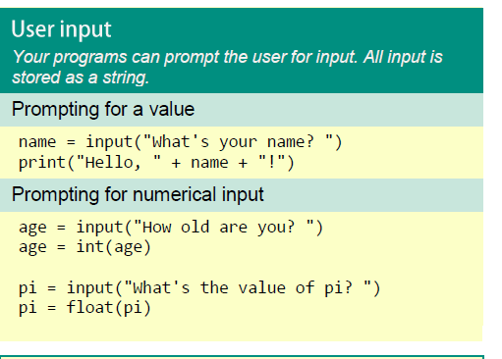
User Inputs
The next part of the lesson will be: https://tinyurl.com/y6egzg64
You can also run locally with the .py or .pynb files in the module
Notes:
Nothing too tricky here, but worth pointing out a few things:
input() takes one argument, which is the prompt that is displayed to the user. This can be a blank string if you don’t want to display a prompt.
When input() is called it displays the prompt and then waits. It will wait forever, until the user types something (or not) and then hits return (this is really what it’s waiting for).
Whatever the user typed (including, potentially, the blank string) will be returned from input(). This return value can be assigned to a variable (such as response) in our example. Your program can then do whatever it wants with the return value. You’ll do some simple problems using this concept and the others we’ve done before in lab this week.

Slide 4
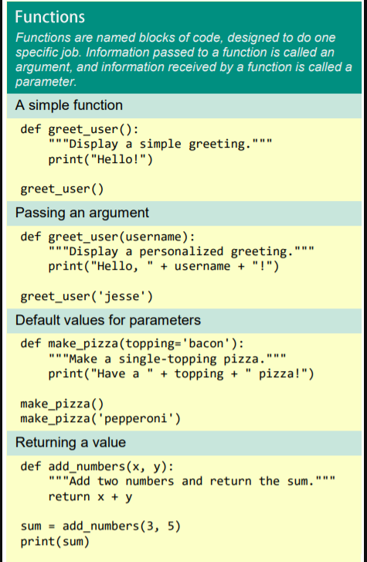
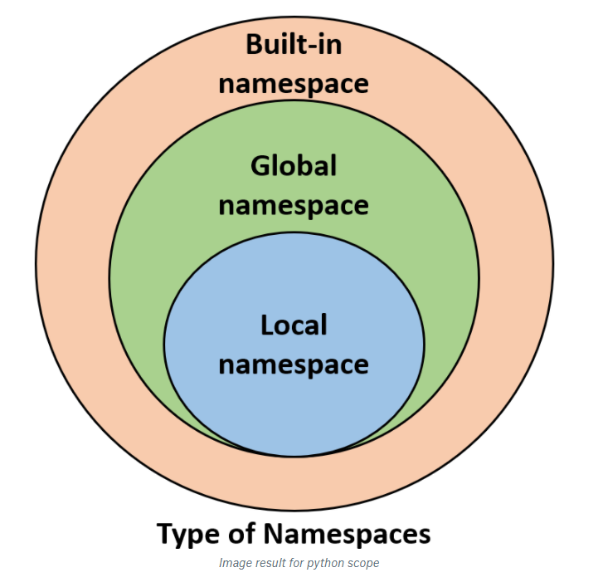
Functions Basics
The next part of the lesson will be: https://tinyurl.com/y6mblg8s
You can also run locally with the .py or .pynb files in the module
Notes:
Nothing too tricky here, but worth pointing out a few things:
input() takes one argument, which is the prompt that is displayed to the user. This can be a blank string if you don’t want to display a prompt.
When input() is called it displays the prompt and then waits. It will wait forever, until the user types something (or not) and then hits return (this is really what it’s waiting for).
Whatever the user typed (including, potentially, the blank string) will be returned from input(). This return value can be assigned to a variable (such as response) in our example. Your program can then do whatever it wants with the return value. You’ll do some simple problems using this concept and the others we’ve done before in lab this week.

Slide 5
Functions Wrap-up

Slide 6
Norms & Practices of Functions
Best Practices for Functions
use descriptive names (long and clear is better than short and cryptic)
Single Responsibility Rule
Keep functions short (<50 lines is a good guideline)
Avoid side effects
don't pass parameters you don't need
don't reference global variables
keep functions 'pure' by returning copies (this is controversial)
document your functions

Slide 7
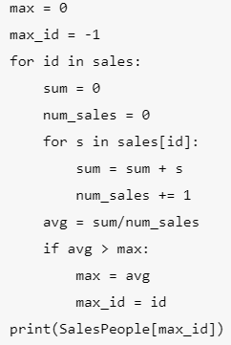

Descriptive Names
Functions simplify code – but only if the names are human interpretable
Original
interpretable
Useless

Slide 8
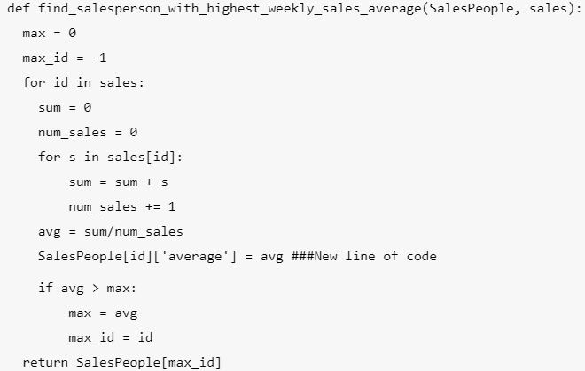
Single responsibility rule
Below we add 1 line to our first function from our last lesson
Seems useful but creates some downsides:
The function name is no longer descriptive
potentially duplicates effort
may create mis-matched formats
Single Responsibility Rule: Just write two different functions
See best practice on next slide

Slide 9
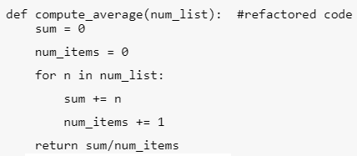

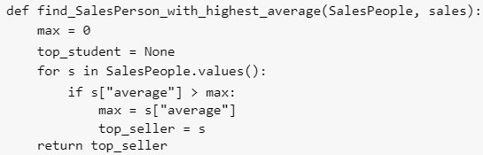
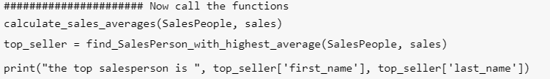
Best Practice

Slide 10
Keep Functions Short
50 lines or less

Slide 11
Avoid Side Effects
Let’s re-examine one of our earlier codes
This is actually not great.
The parameter SalesPeople is modified - and it doesn't return anything.
The caller (person who calls the function) doesn't know if it ran or not.
This is tough to fix. Suggestion:
return something: return the SalesPerson dictionary to hint that it was changed
but notice that the parameter entered is the same as the object returned...
Therefore
Is the same as

Slide 12
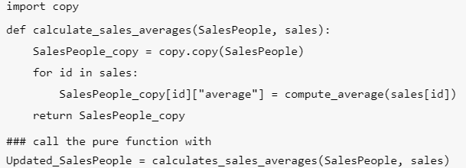
Keep functions pure?
Pure means:
No side effects
Don’t affect anything other than what is returned
Don’t access global variables other than parameter
Accomplish this by using copy
Here is a pure version of the calculate_sales_averages() function
Now the object that is returned from calculate_sales_averages() is actually different than the object SalesPeople that was passed into it
Are there downsides?

Slide 13


Downsides of Pure programming
This approach has downsides too:
Large objects are expensive
Complex Objects don't copy well
particularly true for objects with a lot of references to other objects.
Truly pure programming is overkill. but one good lesson is NEVER modify a global variable if you can avoid it. And if you can't use the local reference.
So
Is preferable to

Slide 14
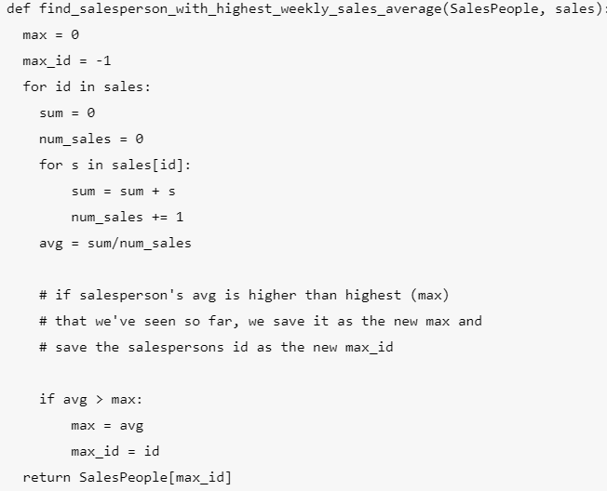
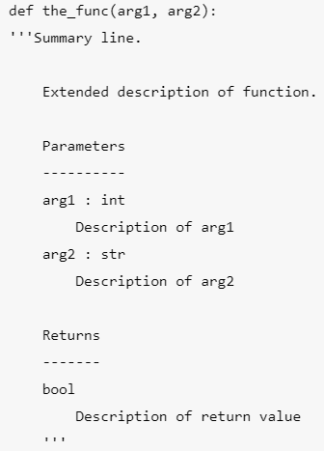
Docstrings! Documentation is critical
The Numpy Standard https://queirozf.com/entries/python-docstrings-reference-examples#numpy-style

Slide 15
PEP8
https://pep8.org/
https://pypi.org/project/pep8/

Slide 16
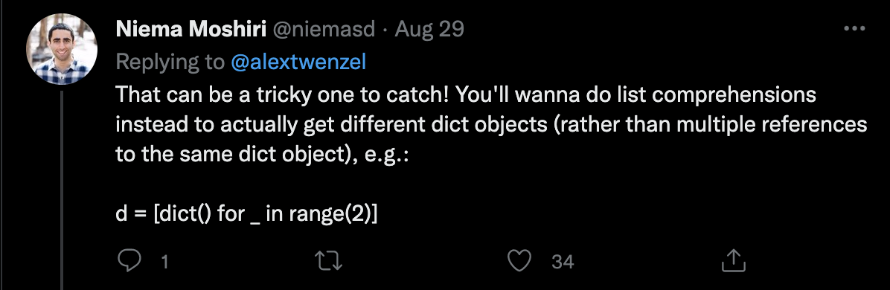
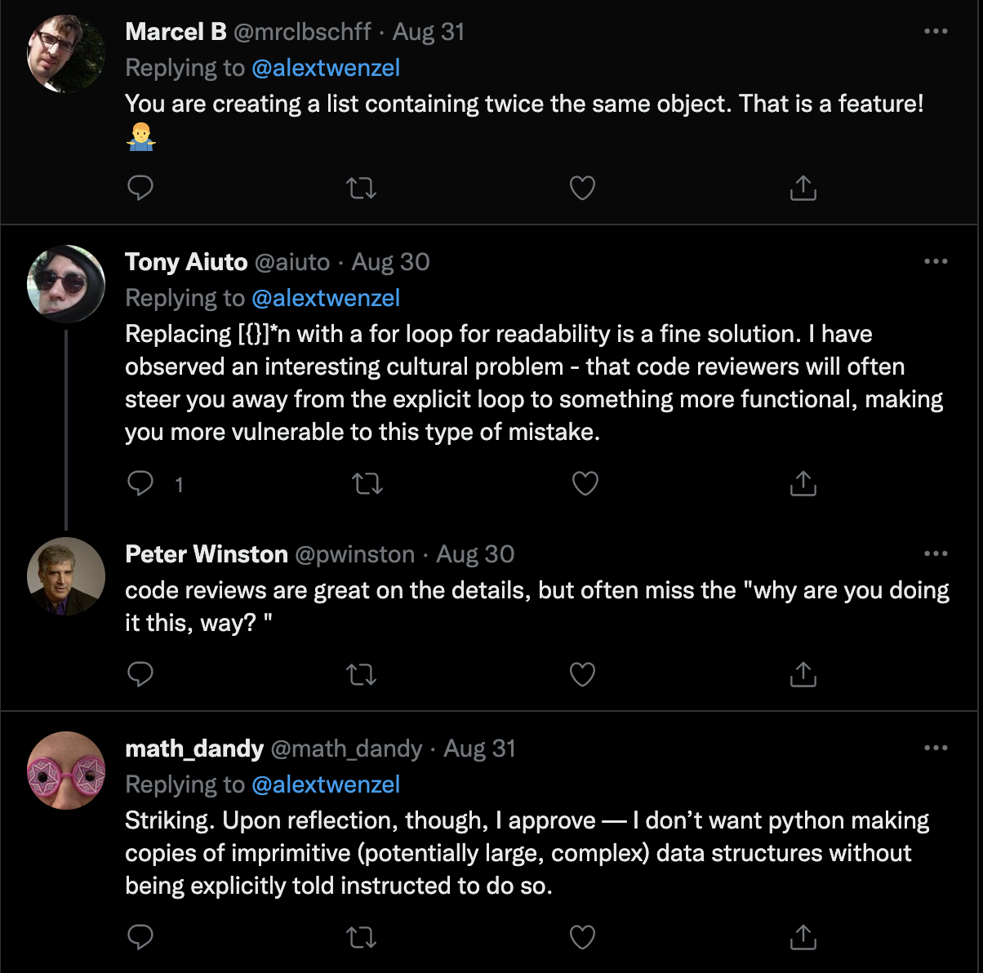
Let’s Check Back with ALex

